Slide 1
GAR
Session 11: Geometry Wars
Notes:
Welcome. Today we build Geometry Wars. The main topic: components vs. systems.
Start by playing the finished game, GeometryWars6, before any code.

Slide 2
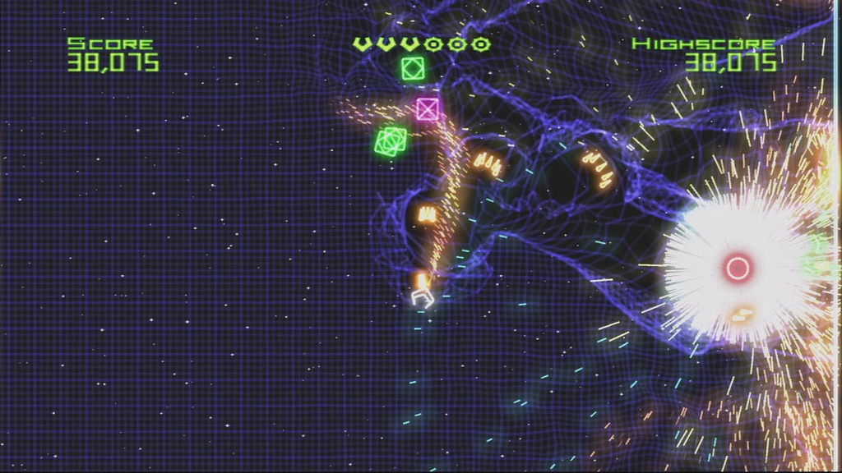
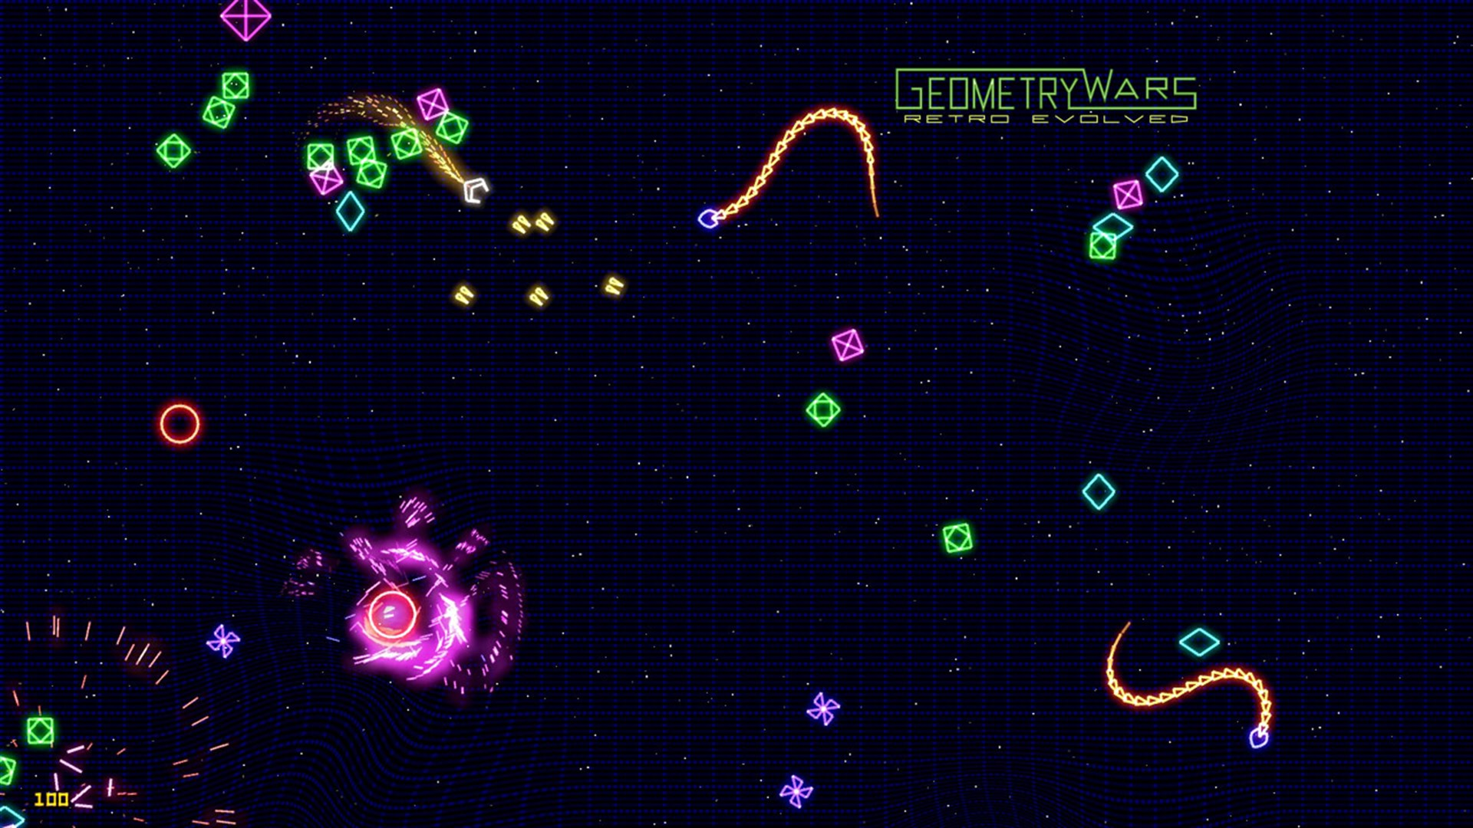
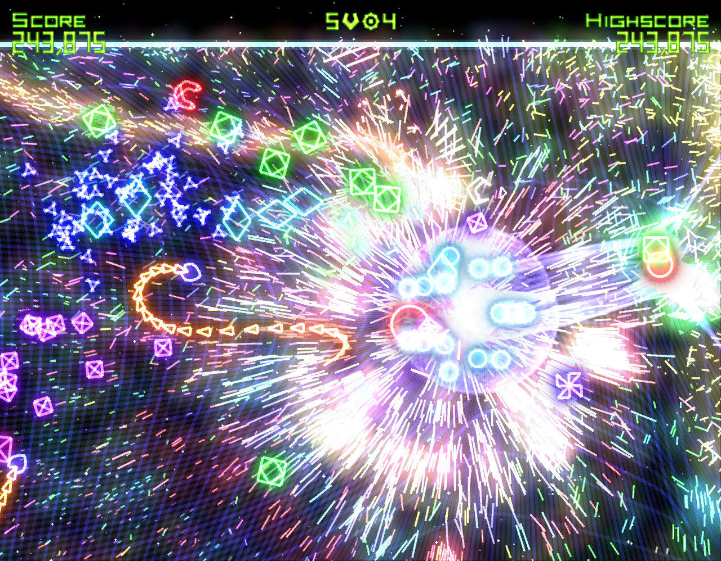

Geometry Wars
Geometry Wars (Bizarre Creations, from 2003). Screenshots © Bizarre Creations / Microsoft.
Notes:
The original on Xbox 360, 2005: neon shapes, hundreds of enemies, particles everywhere.

Slide 3
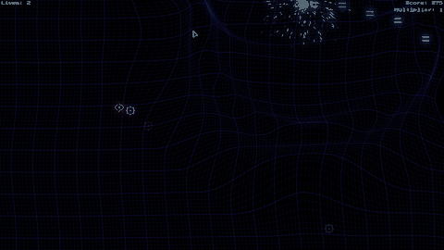
Today’s Goal
Notes:
Run GeometryWars6 and play it for a minute.
Ask: what would you need to build this? Collect answers on the board, and come back to them at the end.

Slide 4
Today’s Topics
Components vs. Systems
Dependency Injection
Object Pool Pattern
Flyweight Pattern
Particles as a System
Shaders (demo)
Notes:
The main topic: components vs. systems, at a scale where it matters. Then dependency injection, Object Pool, Flyweight, and shaders as a demo.

Slide 5
Why Geometry Wars?
Thousands of entities on screen
Built from components, as in Plants vs. Zombies
At this size: which behaviour belongs in a component, and which in a system?
And how does every component get the services it needs?
Notes:
Thousands of entities, built from components as in Plants vs. Zombies. Two new questions: what belongs in a component, and how does everything get its services?

Slide 6
Source Code
github.com/Metamate/gar-games, folder 11-geometry-wars
Its README: the steps (GeometryWars0 to GeometryWars6, and the tests), where things are in the code, how to run it
You don’t need to understand every system: today is about the overall architecture
Notes:
Open gar-games/11-geometry-wars live. Show the README: the step table, the code map, how to run a step.
Say: the site explains the ideas, the README helps you find them in the code, the slides are for today.

Slide 7
Steps
GeometryWars0: entities & components, the player ship
GeometryWars1: shooting & Object Pool
GeometryWars2: enemies, collisions, score and lives
GeometryWars3: particles
GeometryWars4: the spring grid and black holes
GeometryWars5: bloom
GeometryWars6: audio (the finished game)
GeometryWars.Tests: unit tests with fakes
Notes:
Each step adds components to the recipes, and the systems they need. The tests are in their own project.

Slide 8
Explore the Codebase
Take ~10 minutes to browse the finished game, GeometryWars6. Use the README as a guide if you need it.
Clone the repository and build and play the game
  How high a score can you get? ;)
How is the codebase split between the core library and the geometry wars-specific project?
Notes:
Ten minutes: play it, then find the split between GMDCore and the game.

Slide 9
High-Level Architecture
Each layer owns one thing.
Game1: the application: window, services, the state stack
PlayState: one game in progress: pause, game over
PlaySession: one run: score, grid, particles, enemies
EntityWorld · EntityFactory: updating entities · building them from components
Components: one capability each: the actual behaviour
Notes:
Top to bottom: each layer owns one thing. PlaySession is highlighted: it owns one run, and most of today’s rules live there.

Slide 10
Components at Scale
An enemy is a bag of components, composed in EntityFactory. No class per enemy type.
Health
FaceVelocity
a seeker
(an Entity)
SeekTarget
TakeDamageOnBulletCollision
Notes:
A seeker is an entity with these components, composed in EntityFactory. No class per enemy type.

Slide 11
Components vs. Systems
A component is about its owner. Rules that span many entities belong in systems.
Component
its own state, and what happens to it
Health · Weapon · SeekTarget
System
many entities, or the whole run
CollisionSystem · EnemyDirector
BulletSpawner · PlaySession
A component that reaches into other entities should probably be a system.
Notes:
A component is about its owner. Rules that span many entities (which pairs collide, when enemies spawn) belong in systems.
The line at the bottom is the one to remember.

Slide 12
Components vs. Systems in Geometry Wars
The player dies: the component notices, the run reacts.
BeginRespawnOnLethalCollision
a component: my player was hit
PlaySession
the run: clear enemies, reset spawning
Particles: thousands of sparks, no entities at all
one ParticleManager updates them in bulk
All the way: an ECS. Entities are IDs, components are data, all behaviour is in systems.
Notes:
The respawn example: the component notices its player was hit; the run clears the arena. Particles are the extreme: no entities at all.
An ECS takes this all the way: entities are IDs, all behaviour in systems.

Slide 13
Try It: Take a Part Away
In EntityFactory.CreateSeeker:
Remove the SeekTarget component
What does a seeker do now? What still works?
Notes:
Pairs, about 5 minutes. It drifts: movement, collisions, health and score still work, because each is its own component.

Slide 14
Dependency Injection
Components need shared services: input, assets, audio, frame time
Pokemon looked them up in a Service Locator
Geometry Wars passes them in
  Game1 creates them once, in a PlayContext
  A constructor shows what a class needs
  A test can pass in a fake
Cost: passed through every layer that needs it
public sealed class PlayContext
{
public FrameInfo Frame { get; }
public GameController Controller { get; }
public GameAssets Assets { get; }
public AudioManager Audio { get; }
public PerformanceMonitor Performance { get; }
public PlayContext(FrameInfo frame,
GameController controller, ...)
{ ... }
}
Notes:
Pokemon looked services up; here they’re passed in, bundled in a PlayContext. A constructor shows what a class needs.

Slide 15
Three Ways to Reach a Service
Three ways to reach a service, all seen in this course.
Singleton (Flappy)
Audio.Instance
one concrete class,
hard to replace
Service Locator (Pokemon)
Locator.Audio
an interface,
replaceable at runtime
Dependency injection
passed in
visible in the constructor,
replaced when constructing
Which fits depends on how many classes need the service, and how deep.
Notes:
The three we’ve seen: Singleton, Service Locator, dependency injection. Ask: which would you use for audio in your project, and why?

Slide 16
Testing With Fakes
AwardScoreOnDestroyed needs a score tracker
  It gets an IScoreTracker in its constructor
So a test passes in a fake
  A small class that records what it was asked
One entity, two components, no world
ScoreTracker gets time through FrameInfo
  The test decides how much time passes
class FakeScoreTracker : IScoreTracker
{
public List<int> PointsAdded { get; } = [];
public void AddPoints(int points) =>
PointsAdded.Add(points);
// ...
}
[Fact]
public void Destroying_the_enemy_awards_its_points()
{
var score = new FakeScoreTracker();
var enemy = new Entity();
var d = enemy.AddComponent(new Destroyable());
enemy.AddComponent(
new AwardScoreOnDestroyed(score, 50));
enemy.Start();
d.Destroy();
Assert.Equal([50], score.PointsAdded);
}
Notes:
Because the score tracker is passed in, a test can pass a fake that only records calls. One entity, two components, no world.

Slide 17
Object Pool - The Problem
The game stutters every few seconds. Why?
20 bullets a second
30 particles per hit
50 pieces per enemy
Thousands of short-lived objects every second, each one new
the garbage collector cleans them up, and pauses when it likes
What if nothing were ever new during play?
Notes:
Ask the first question: why does it stutter? The numbers: thousands of short-lived objects a second, and the garbage collector pausing to clean up.
Ask the last one: what if nothing were new during play? That’s the pool.

Slide 18
Object Pool - Simple Example
public class ParticlePool {
Particle[] items = new Particle[5000];
public ParticlePool() {
for (int i = 0; i < items.Length; i++) items[i] = new Particle();
}
public Particle Spawn(Vector2 pos) {
for (int i = 0; i < items.Length; i++) {
if (!items[i].Active) {
items[i].Reset(pos);
items[i].Active = true;
return items[i];
}
}
return null; // pool exhausted: size it generously
}
}
Notes:
Allocate everything once; spawning finds an inactive one and resets it. Releasing is setting Active to false. Reset everything, or old state leaks in.

Slide 19
Object Pool Implementation
ObjectPool.cs
BulletSpawner.cs
Step: GeometryWars1
Notes:
Show ObjectPool.cs and BulletSpawner.cs from GeometryWars1. Press F3 in the game: memory stays flat while firing.

Slide 20
Try It: Watch the Memory
In GeometryWars6, press F3
Keep firing for ten seconds: does memory grow?
What would you expect without the pool?
Notes:
Pairs, about 3 minutes. It stays flat: the bullets are reused. Without the pool, memory would climb and drop with each collection. Exercise 5 measures it.

Slide 21
Flyweight Pattern
The shared, unchanging data is stored once; each enemy keeps only its own.
EnemyType: shared, immutable
texture · speed · health · score
an enemy
position · velocity · HP
an enemy
position · velocity · HP
an enemy
position · velocity · HP
an enemy
position · velocity · HP
500 enemies: 500 references to one texture, not 500 copies.
Notes:
One type holds what’s shared: the texture and the stats. Each enemy holds only its own position, velocity and HP.

Slide 22
Flyweight Example
// Intrinsic (shared): one instance, referenced everywhere
public class EnemyType {
public Texture2D Texture;
public float MaxSpeed, SpawnHP;
public int ScoreValue;
}
// Extrinsic (per-instance): one per live enemy
public struct EnemyInstance {
public EnemyType Type; // a reference to the flyweight
public Vector2 Position, Velocity;
public int CurrentHP;
}
// Draw: SpriteBatch batches draws of the same texture automatically
foreach (var e in enemies)
spriteBatch.Draw(e.Type.Texture, e.Position, Color.White);
Notes:
The code for the diagram. SpriteBatch is a flyweight too: one texture state for hundreds of sprites.

Slide 23
Flyweight Implementations
GameAssets.cs
GameplayDefinitions.cs
Step: GeometryWars0 onwards
Notes:
Show GameAssets.cs and GameplayDefinitions.cs.

Slide 24
Shaders
Shaders move work to the GPU: thousands of small cores, all running the same program.
Vertex shader
once per vertex:
where things are
Pixel shader
once per pixel:
what colour it is
MonoGame has a default shader; custom ones are HLSL .fx files.
Any per-pixel effect: glow, blur, distortion, colour grading.
Notes:
Shaders run on the GPU: thousands of small cores, one program. A vertex shader decides where; a pixel shader decides what colour.

Slide 25
Bloom, The Signature Geometry Wars Glow
Bloom: bright pixels bleed light into their neighbours.
Draw the scene
to a texture
Keep the
bright pixels
Blur them
across
Blur them
down
Add them back
over the scene
Each step is one full-screen pass with its own pixel shader: post-processing.
Notes:
Follow the passes: draw to a texture, keep the bright pixels, blur them twice, add them back. Each pass is a full-screen pixel shader.

Slide 26
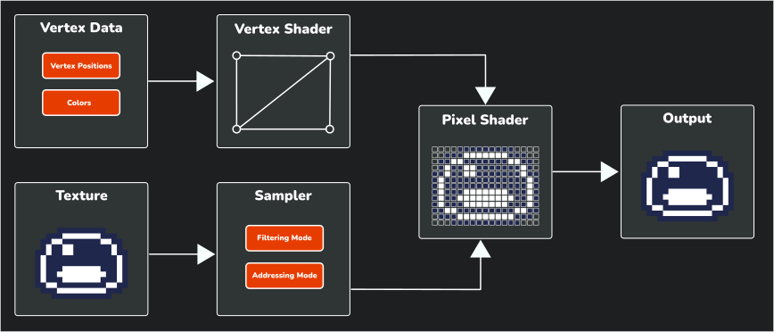
The Shader Pipeline
Notes:
The whole pipeline, for reference: vertices in, pixels out.

Slide 27
Shader Implementation
Notes:
Demo: GeometryWars4 and GeometryWars5 side by side: the same game without and with bloom. Show the three .fx files. A showcase only; not needed for the project.

Slide 28
Summary
Six questions every entity answers.
What it is
Components
Rules across entities
Systems
Where services come from
Dependency injection
When it’s allocated
Object Pool
What it shares
Flyweight
How it looks
Shaders
Notes:
Six questions every entity answers, and today’s answer to each. Read them back as a recap.

Slide 29
Exercises
Start from GeometryWars6. Full instructions are on the course site.
A new enemy from existing components; then a shield component
A bomb, one per life: which parts are components, which a system?
A screen-shake service in PlayContext; a FakeBulletSpawner test
Measure the pool: allocations and GCs, with and without it
Notes:
Start from GeometryWars6. The bomb exercise is the key one: which parts are components, which a system?
Full instructions are on the course site; students work from there. Walk round while they work.

Slide 30
Check Yourself
When should behaviour live in a system rather than a component?
What does dependency injection give you that a Service Locator doesn’t?
What is a fake, and why does dependency injection make it easy to use one?
What is the difference between Object Pool and Flyweight?
The answers, and more questions, are on the course site.
Notes:
Ask one question at a time. Pairs discuss for a minute, then take two or three answers.
Expected answers (from the course site):
Q: When should behaviour live in a system rather than a component?
A: When it spans many entities, owns rules of the whole game or session, or needs a central order. A component should be about its owner; otherwise it ends up reaching into other entities.
Q: What does dependency injection give you that a Service Locator doesn't?
A: The dependencies are explicit: a constructor shows what a class needs, and a test can pass in a replacement. The cost is that services must be passed through every layer that needs them.
Q: What is a fake, and why does dependency injection make it easy to use one?
A: A small stand-in for a real dependency, written for a test, that records what it was asked to do. When a class gets its dependencies through its constructor, the test simply passes the fake in. When the class finds them itself (a Singleton or a Service Locator), the fake has to replace global state, or can't be used at all.
Q: What is the difference between Object Pool and Flyweight?
A: Object Pool reuses _instances_ to avoid allocation over time. Flyweight shares _data_ between many instances to avoid duplicating it.

Slide 31
Apply It to Your Project
Which of your game’s rules are about one entity, and which span many?
  Where do they live today?
How do your classes get shared services?
  Would passing them in make the dependencies clearer?
Does anything in your game allocate every frame?
Notes:
Give the project groups five minutes with these questions.
Ask two groups to share one answer each, and push them to name actual classes and files.

Slide 32
Your Course Project
Milestone by today
  A release build on itch.io, and a README started
Final milestone, by session 12
  README complete, repository link uploaded to itslearning
Notes:
Milestone today: a release on itch.io and a README started. Final milestone by session 12: the README complete.

